Slide 1
The Music of the Stars and the Search for New Worlds
Tiago Campante
University of Birmingham
campante@bison.ph.bham.ac.uk
Notes:
Good evening everyone. My name is Tiago Campante and I am a Research Fellow at the School of Physics and Astronomy right here at the University of Birmingham.
Sir Arthur Eddington once famously lamented: "What appliance can pierce through the outer layers of a star and test the conditions within?"
And so, myself and a few others have tirelessly been working on the answer to that question. You see, I study distant stars by 'listening' to the sound trapped in their interiors. This novel technique, called asteroseismology, allows astronomers to take measurements of a star's vital characteristics (such as its mass, size and age), and with this information at hand we are then able to characterise any planets in orbit around the star with unprecedented precision. Therefore, the title of my talk: The music of the stars and the search for new worlds.

Slide 2
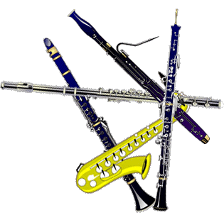
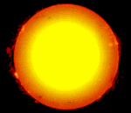
The resonant Sun
The Sun resonates like a musical instrument!
Notes:
Perhaps unbeknown to many of you, the Sun is a large, oscillating ball of gas. The driving agent causing these oscillations is turbulence in the convective layers near the solar surface. This produces sound waves that get trapped in the Sun’s interior, making it resonate just like a musical instrument.
This ray diagram shows the paths taken by these waves, where we can see how they are reflected at the surface only to be refracted back outward. Different waves penetrate to different depths.
The trapped sound manifests itself indirectly as gentle pulsations of the Sun’s surface with amplitudes of only a few m/s. That’s no more than walking pace!

Slide 3
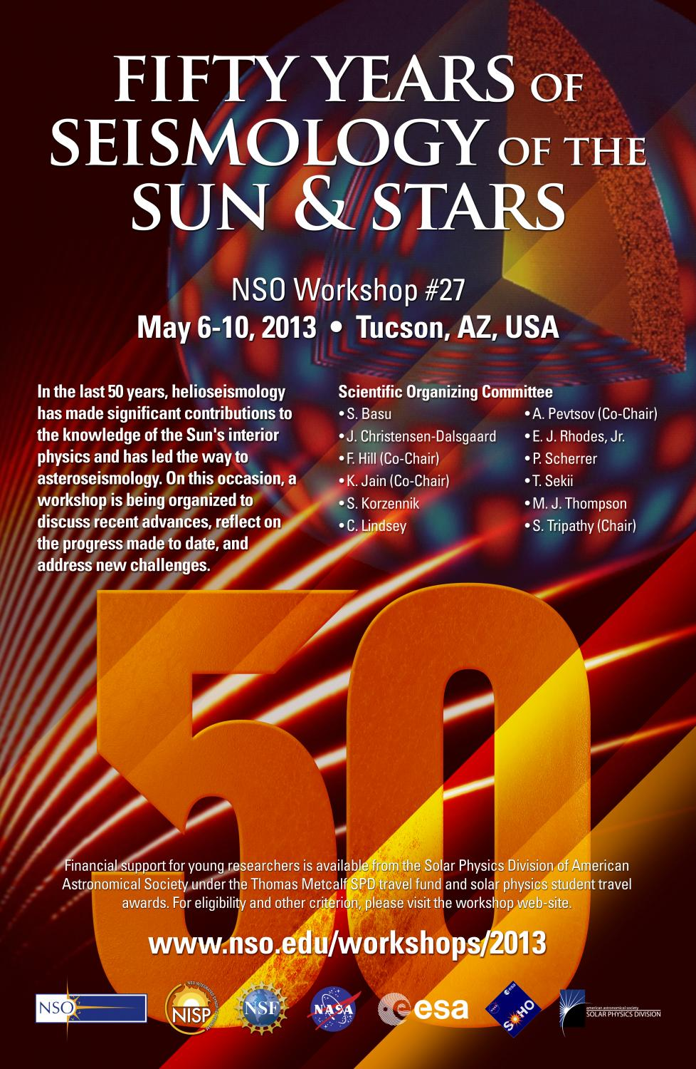
helioseismology, n.
The study of the Sun's interior by the observation and analysis of oscillations at its surface. Cf. asteroseismology
[Oxford English Dictionary]
Notes:
The first detections of oscillations in the Sun date back to the 1960s and paved the way for the development of helioseismology. Helioseismology is the study of the Sun’s interior by the observation and analysis of oscillations at its surface.

Slide 4
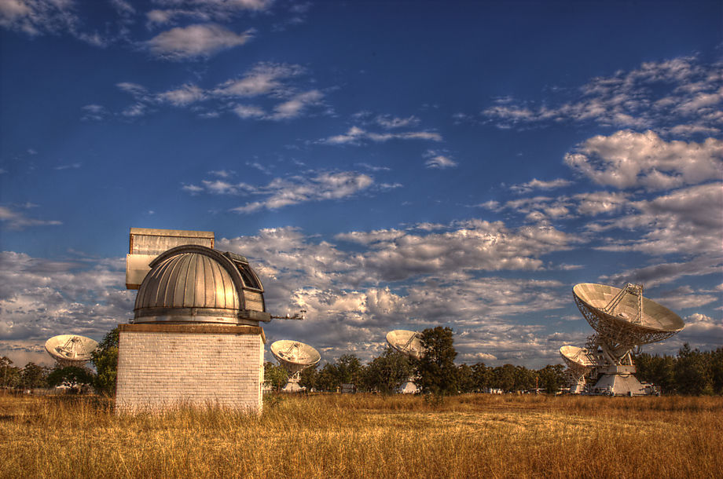
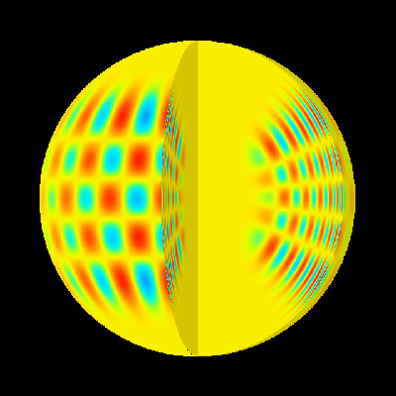
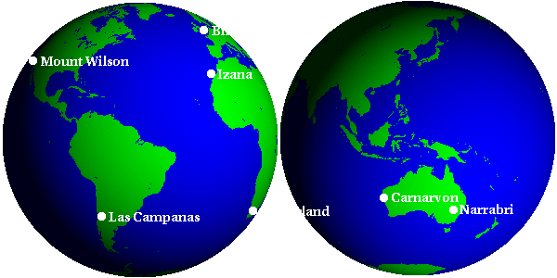
Birmingham Solar-Oscillations Network (BiSON)
http://bison.ph.bham.ac.uk/
Notes:
At the University of Birmingham we have been playing a leading role in the seismic study of the Sun over the past few decades. We run the so-called Birmingham Solar-Oscillations Network (BiSON). BiSON is a worldwide network of six remote, ground-based telescopes that continuously monitor the Sun.
The BiSON spectrometers are sensitive to spectral lines in sunlight. By observing the Doppler shifts of these spectral lines we are able to reconstruct the movement of the solar surface and to determine the dominant frequencies present in the data.

Slide 5
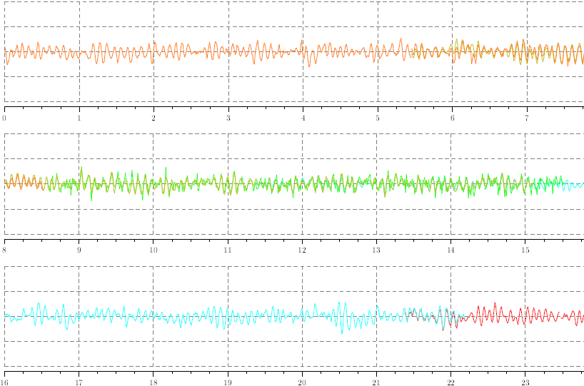

“Sun quakes”
Oscillation velocity (m/s)
Time (hours UTC)
Notes:
Here we see 1 day worth of data collected by BiSON, where we plot oscillation velocity as a function of time. If we look closer, we can see that the dominant modes of oscillation in the Sun have periods of about 5 minutes or, equivalently, frequencies of approximately 3 mHz.
These frequencies are too low to be audible to humans. So, in order to find out how the Sun sounds like, we take our data and speed them up some 100,000 times. This effectively converts a 3 mHz signal into a 300 Hz signal, now well within our audible range. So this is how the Sun sounds like...

Slide 6
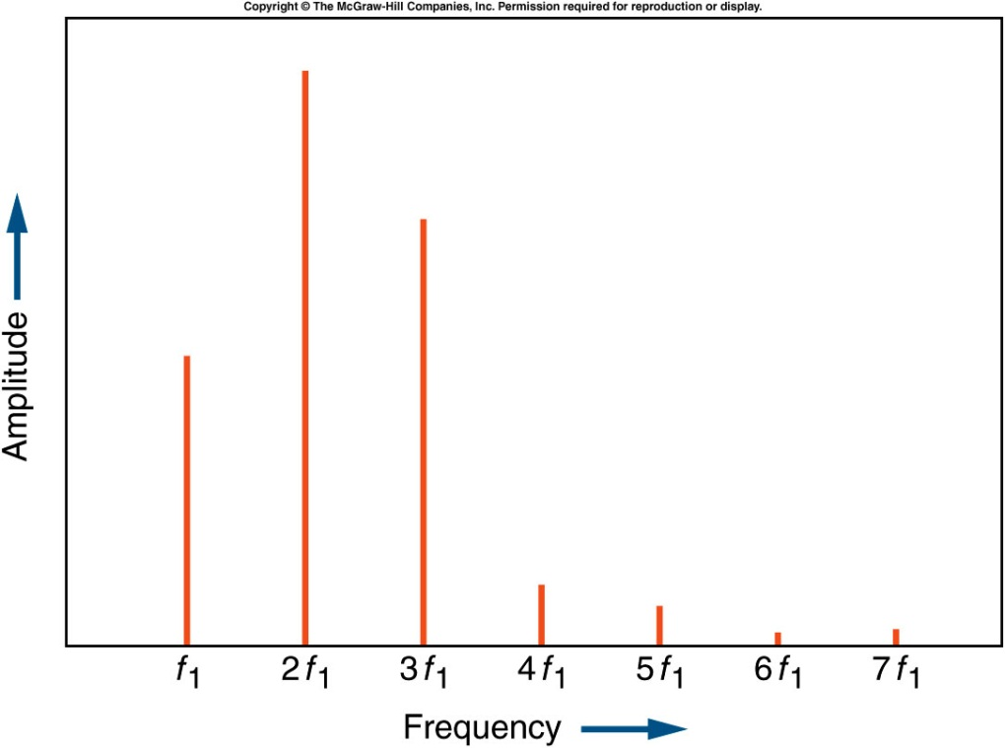
Overtones of an instrument
Frequency spectrum
Notes:
When we play a musical note, say, using a flute, what we hear is a fundamental tone and a series of overtones of that fundamental tone.

Slide 7
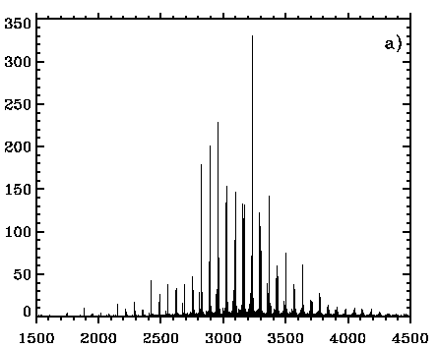
Music of the stars: Sun
Frequency spectrum of the Sun
Strength
Frequency (μHz)
Notes:
Analogously to what happens when we play a musical note, the Sun displays several types of motion, each with its own set of overtones. As a result, what we observe for the Sun is a more complex spectrum that looks like this. This is an actual solar spectrum as obtained by BiSON. As mentioned earlier, the solar spectrum is centred at a frequency of 3 mHz (or a period of 5 minutes).

Slide 8
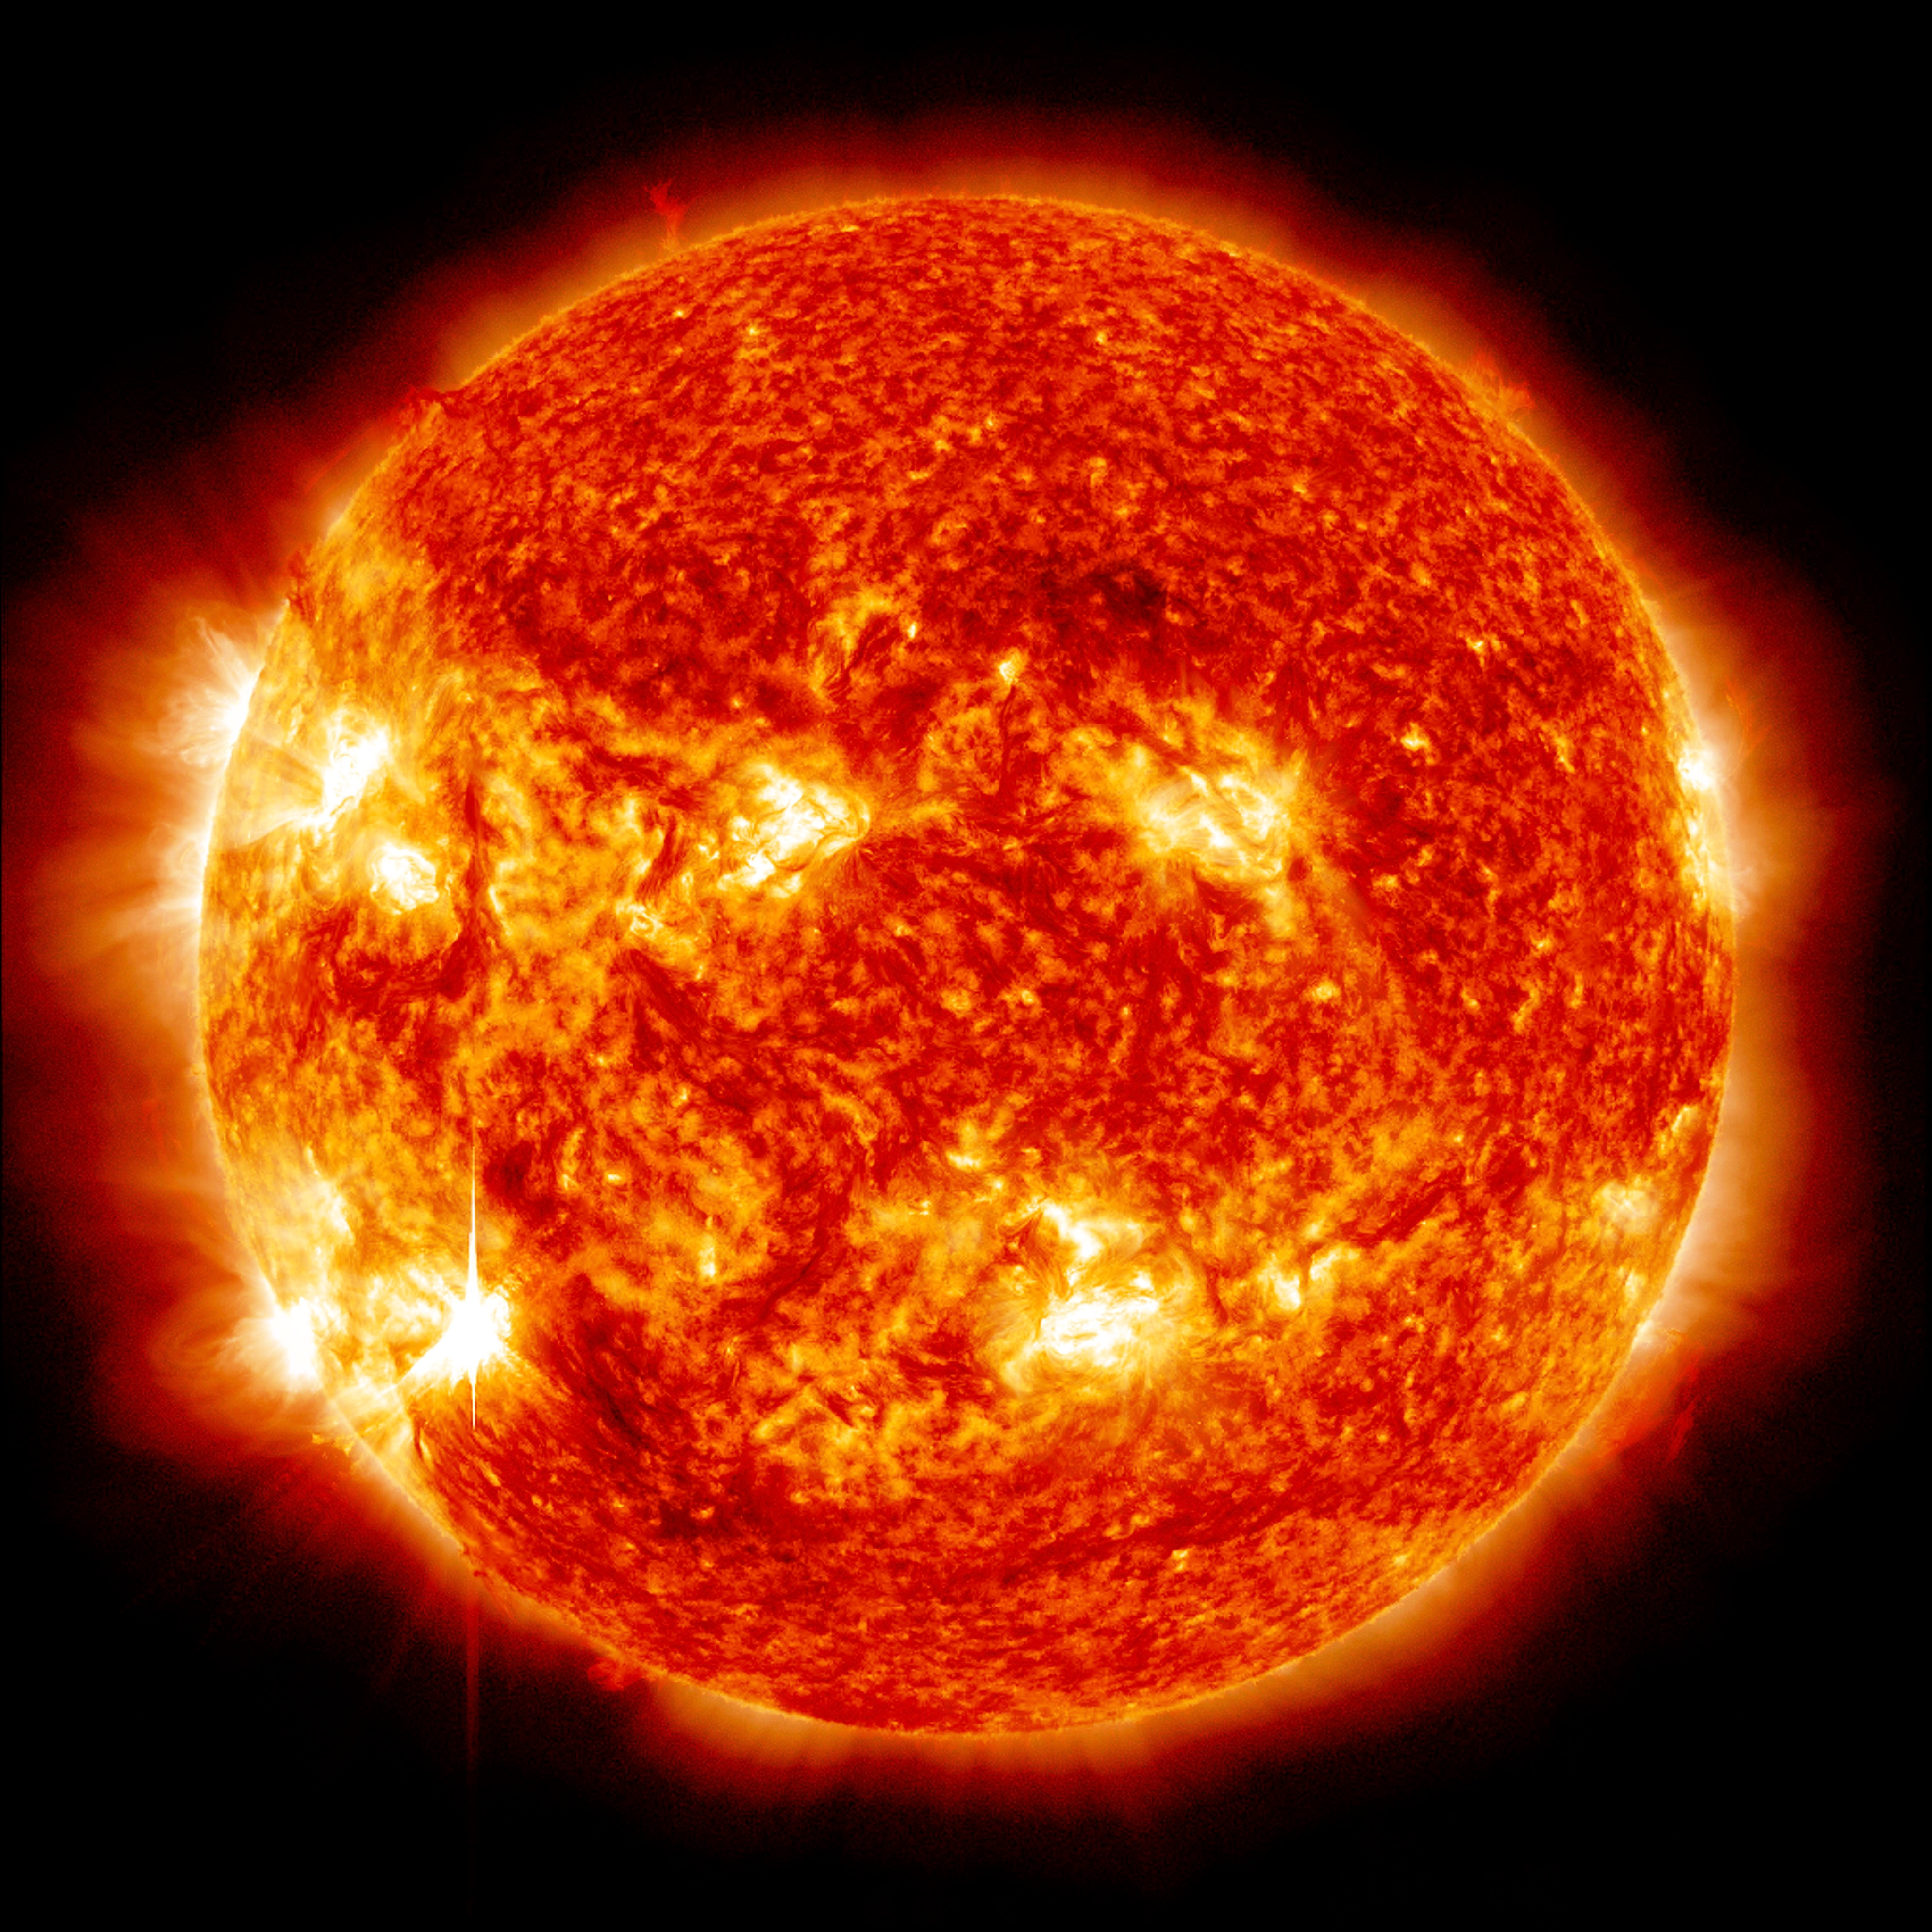
What have we learned from helioseismology?
Notes:
But what have we learned from helioseismology? Through helioseismology, the Sun fulfils the role of a Rosetta Stone for astrophysics. Helioseismology allows us to study the Sun in great detail and through this we can inform our understanding of the life histories of the Sun and other stars.
Helioseismology also allows us to test fundamental physics under the exotic conditions found in the solar interior. Perhaps the most notorious example has been the use of helioseismology in testing the solar neutrino problem, which eventually pointed the way to a solution in particle physics.

Slide 9
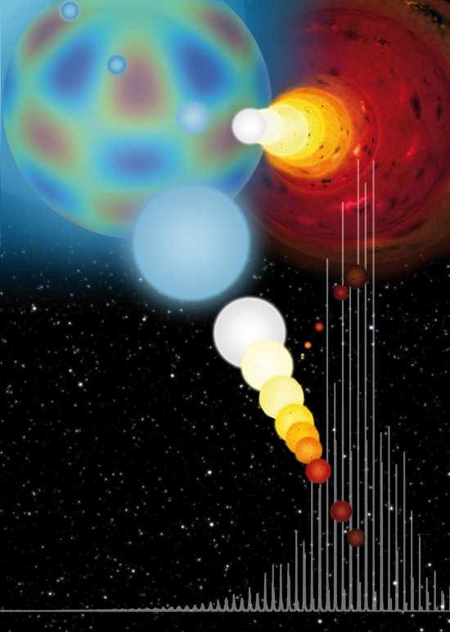
asteroseismology, n.
The study of the interior of stars by the observation and analysis of oscillations at their surface. Cf. helioseismology
[Oxford English Dictionary]
Notes:
The Sun is, however, a single star at a specific evolutionary state, and it is further structurally simple if compared with certain other stars. A logical consequence was, therefore, the advent of asteroseismology, whereby one would expect to be able to probe the interiors of stars other than the Sun through the use of their intrinsic oscillations.

Slide 10


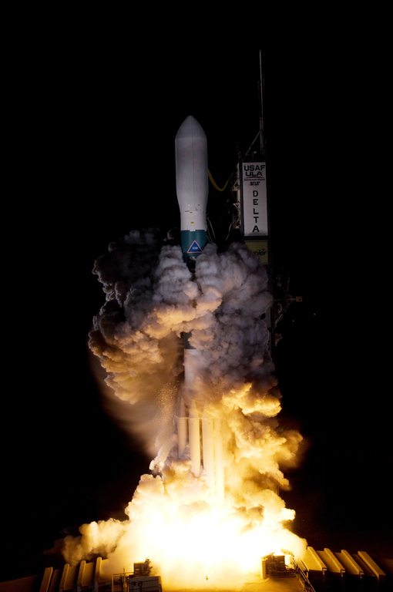
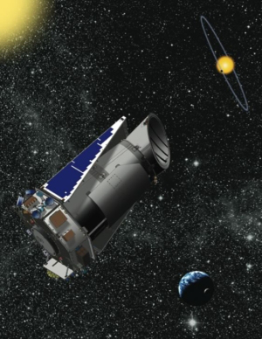
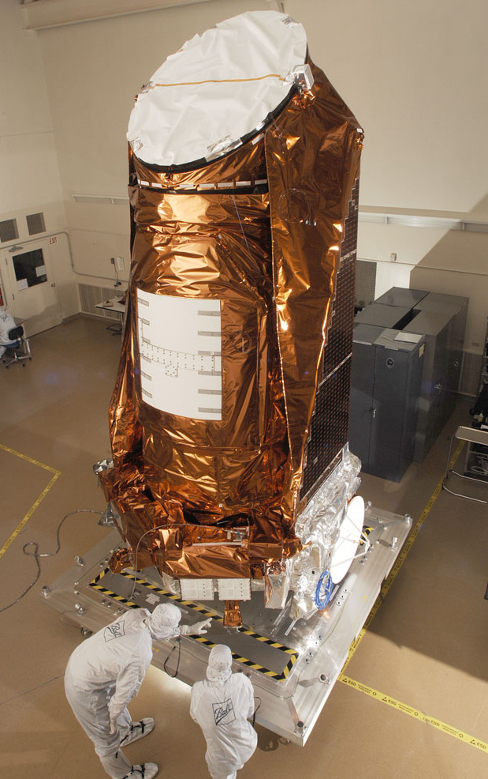
http://keplerscience.arc.nasa.gov/
Notes:
The launch of the NASA Kepler satellite back in 2009 triggered a revolution in the field of asteroseismology.
Kepler operates in an Earth-trailing heliocentric orbit. It consists of a 1-meter aperture photometer capable of producing observations with a precision of a few parts-per-million. That’s a precision of 1 cm in 10 km. So, unlike the Doppler shift measurements made by BiSON, Kepler looks at tiny variations in a star’s brightness.

Slide 11
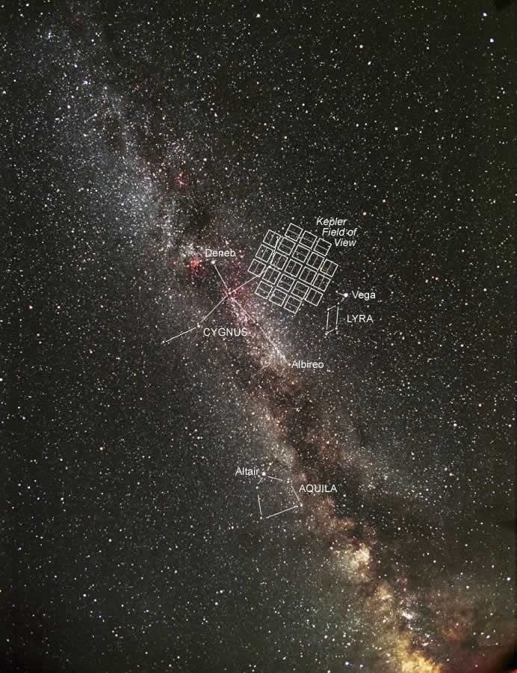
Kepler field-of-view
Notes:
Kepler was designed to survey a small patch of the Milky Way in the northern constellation of Cygnus. Its primary goal was to discover Earth-like planets orbiting other stars and to estimate the rate of occurrence of such planets. To that end, Kepler monitored the brightness of over 150,000 stars.
The high-quality data provided by Kepler are also well suited for conducting asteroseismic studies of stars showing solar-like oscillations. In fact, solar-like oscillations have been detected by Kepler in several thousand main-sequence, subgiant, and red-giant stars.

Slide 12
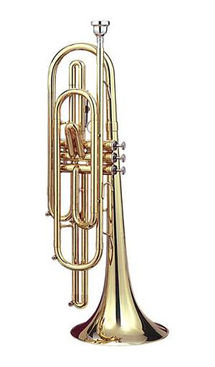
Music of the stars: Sun
Frequency spectrum
Strength
Frequency (μHz)
Notes:
So let us go back to the musical instrument analogy and for a moment let us associate the Sun with a trumpet. Let us hear once more how the Sun sounds like...

Slide 13
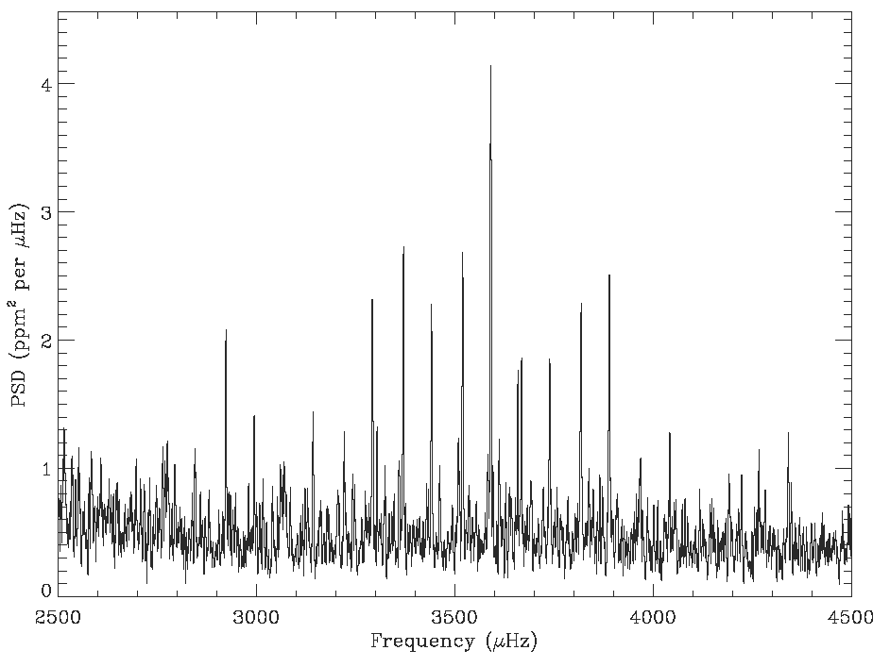
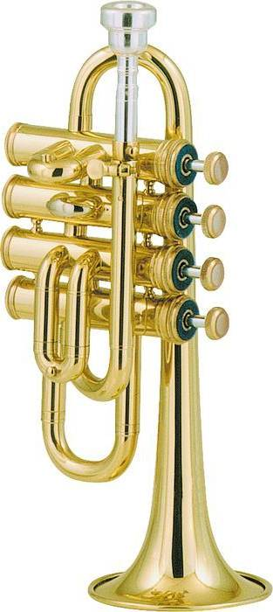
Music of the stars: dwarf star
Frequency spectrum
Strength
Frequency (μHz)
Notes:
And how does a star smaller than the Sun sound like? Well, different instruments have distinct and recognizable pitches. Just like a cornet has a higher pitch than a trumpet, a star smaller than the Sun is expected to display higher-pitch overtones. And that is exactly what we observe. This is how an orange dwarf star sounds like...

Slide 14
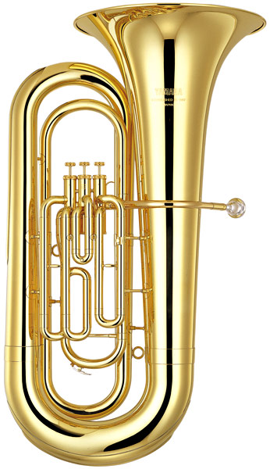
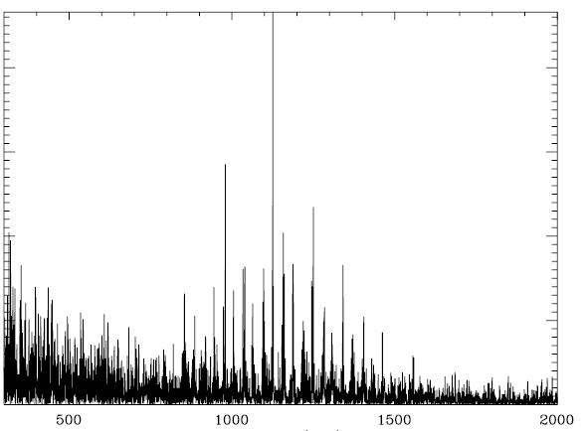
Music of the stars: subgiant star
Frequency spectrum
Strength
Frequency (μHz)
Notes:
The converse is also true. If we consider a star larger than the Sun (say, a tuba in our analogy), we will observe lower-pitch overtones. This is how a subgiant star (i.e., an evolved star whose envelope has started to expand) sounds like...
By now, it should be clear to you that asteroseismology can give us detailed information about the size of a star.

Slide 15
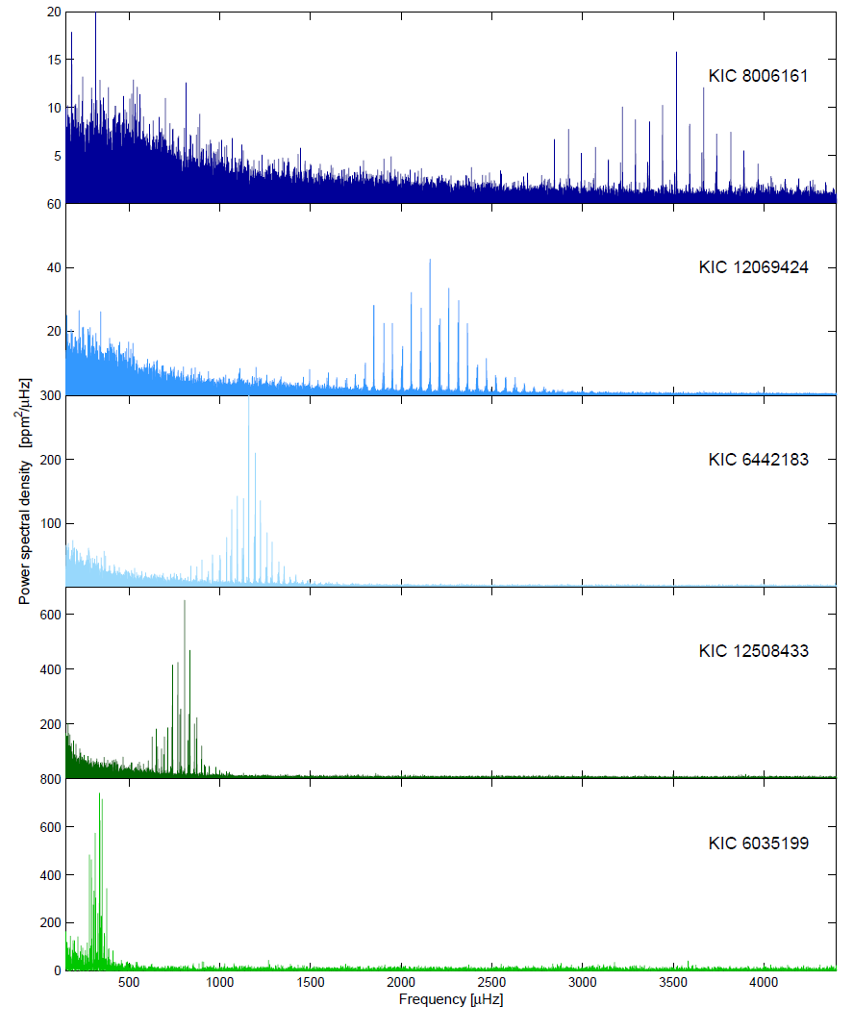
teenager…
“Sun in time”
Kepler sequence of solar-mass stars
young adult…
prime of life…
Increasing
size, age
starting to fill out…
bus pass ordered…
Notes:
Let us now look at a sequence of spectra belonging to solar-mass stars as observed by Kepler. As a solar-mass star gets older (click), so does its size increase, as it evolves from being a main-sequence star, to becoming a subgiant, and later on to becoming a red-giant star. At the same time, we notice how the frequency of its overtones decreases.
Asteroseismology can, therefore, also be used as a means of evaluating the evolutionary state of a star and thus its age.

Slide 16
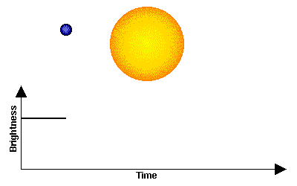
The transit method
Detection of extrasolar planets
Notes:
As mentioned earlier, Kepler’s primary goal is the detection of extrasolar planets. Kepler uses precise photometry to measure periodic dips in starlight due to the transits of planets across the face of their stars. This is called the transit detection method and about 80% of all extrasolar planets known to date have been detected using this method.
Transit observations being an indirect detection method are, however, only capable of providing planetary properties relative to the properties of the parent star. And here resides the importance of the synergy between asteroseismology and exoplanetary science. To be specific, asteroseismology can be used to precisely characterize the host star and thus allow for inferences on the absolute properties of its planetary companions.

Slide 17
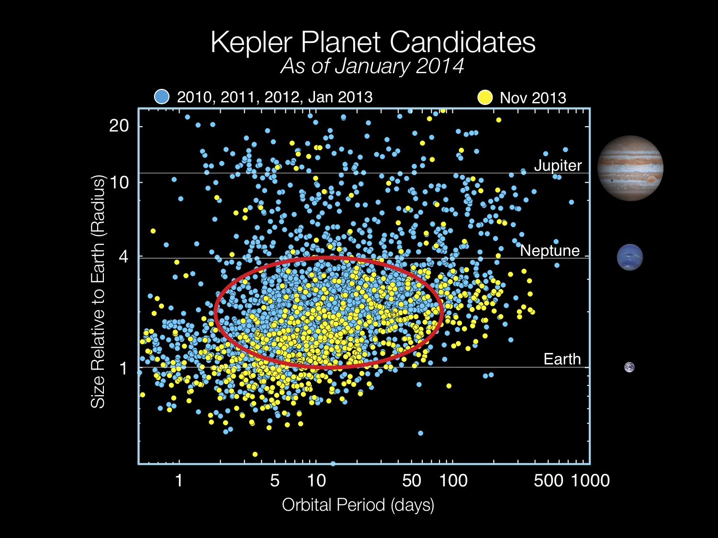
Notes:
Kepler has so far successfully detected over 4,000 planet candidates, of which approximately 40% are in multiple-planet systems.
Plotted here are the radii (in terms of Earth radii) of all planet candidates detected by Kepler as a function of their orbital periods. The most enigmatic aspect of this plot is the fact that 3/4 of all planet candidates have sizes ranging from that of Earth to that of Neptune, which is nearly four times as large as Earth. These planets dominate the Galactic census but are not represented in our Solar System.

Slide 18
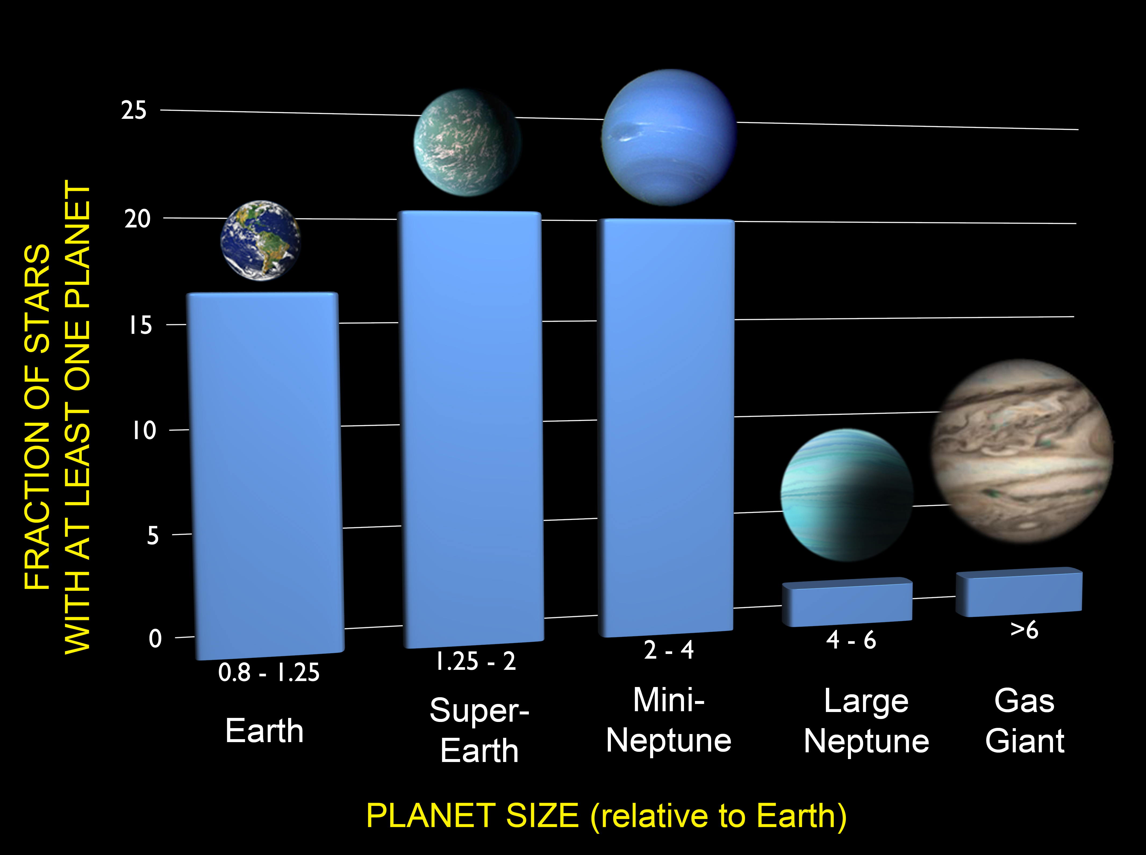
Notes:
A pertinent question would be to ask: How common are Earth-size planets? After correcting for false positives and for the incompleteness of the Kepler sample, a recent analysis showed that at least one in six stars has an Earth-size planet in a close orbit. Since the Milky Way has about 100 billion stars, this means that there are at least 17 billion Earth-size worlds out there! In our Galaxy alone!
About 1/4 of stars have a so-called super-Earth (i.e., with a radius between 1.25 and 2 Earth radii). The same fraction of stars have a mini-Neptune (i.e., with a radius between 2 and 4 Earth radii). Larger planets are much less common. Only about 3% of stars have a large Neptune, and only 5% of stars have a gas giant.

Slide 19
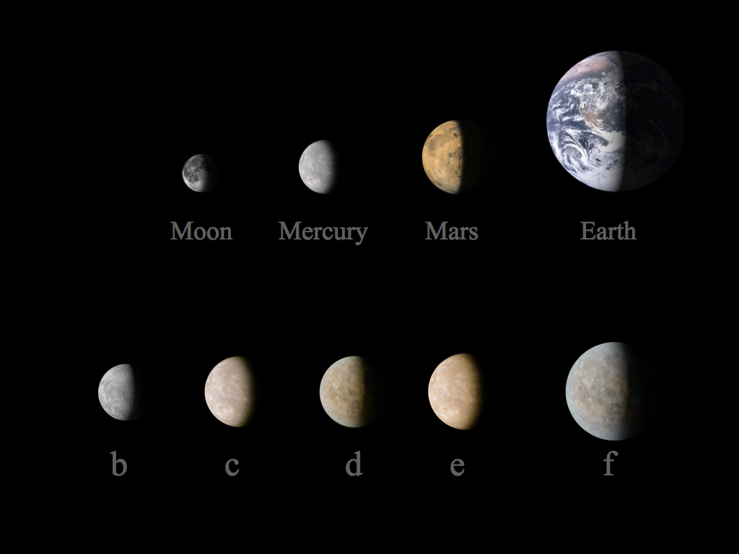
Kepler-444
11.2 billion years old!
Campante et al., 2015, ApJ, 799, 170
Notes:
Let me then present you the Kepler-444 system. The discovery of this system was led by University of Birmingham scientists and it garnered worldwide attention from the media.
This is an ancient extrasolar system hosting 5 planets with sizes between those of Mercury and Venus. We used asteroseismology to measure a precise age of 11.2 billion years for the host star, making this the oldest known system of terrestrial-size planets. Remarkably, by the time Earth formed, these planets were already older than Earth is today.
The implications of this discovery are far-reaching. We showed that Earth-size planets have formed throughout most of the Universe’s history, leaving open the possibility for the existence of ancient life in the Galaxy.

Slide 20
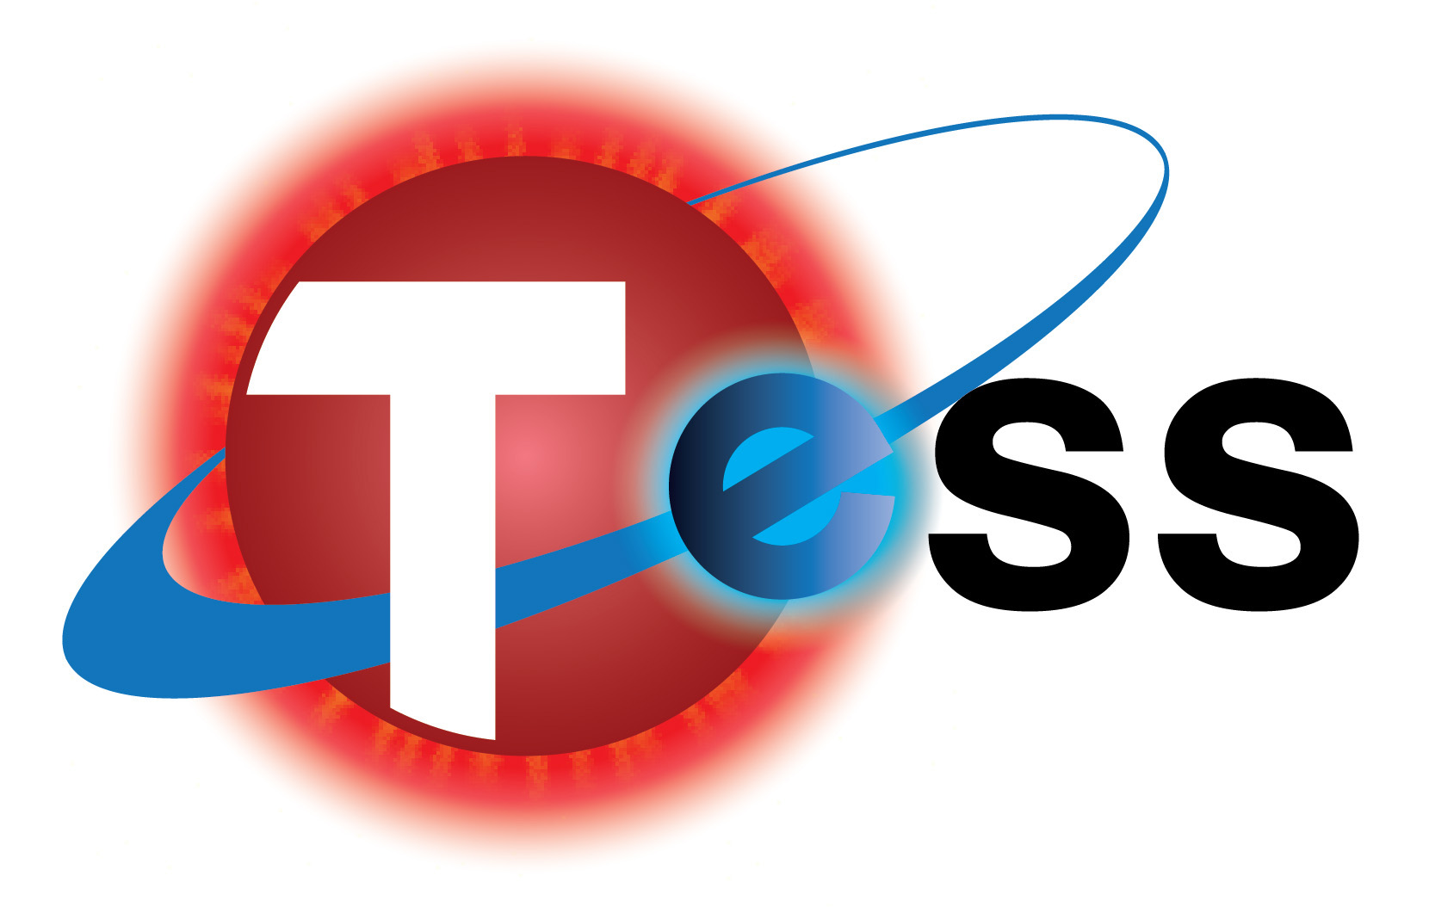
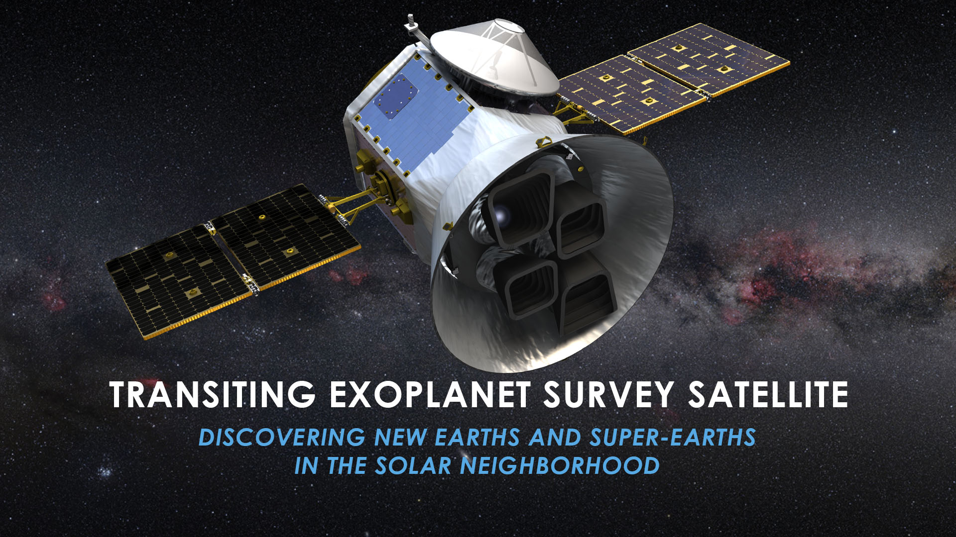
http://tess.gsfc.nasa.gov/
Notes:
And the future looks very promising for planet hunters and asteroseismologists alike. Although there are several ongoing and planned missions devoted to the search for distant planets, there is one that I would like to single out: and that’s TESS, the Transiting Exoplanet Survey Satellite.
TESS is a NASA satellite that will perform an all-sky survey for planets transiting bright nearby stars. Its launch is scheduled for March 2018 and it is expected to detect approximately 17 hundred planets, the majority of which will be small planets in close orbits around their stars.
Moreover, TESS's excellent photometric precision will also enable asteroseismology of several thousand solar-type stars.

Slide 21
The Music of the Stars and the Search for New Worlds
Thank you for listening!
campante@bison.ph.bham.ac.uk
Notes:
And this brings me to my last slide. I sincerely hope you enjoyed my talk and I’m more than happy to take your questions during the Q&A session. Thank you very much for your attention!

